Slide 1
MYLEGION: ONLINE MEMBERSHIP PROCESSING
Renew, transfer and add new members using post and squadron membership processing.
2025

Slide 2
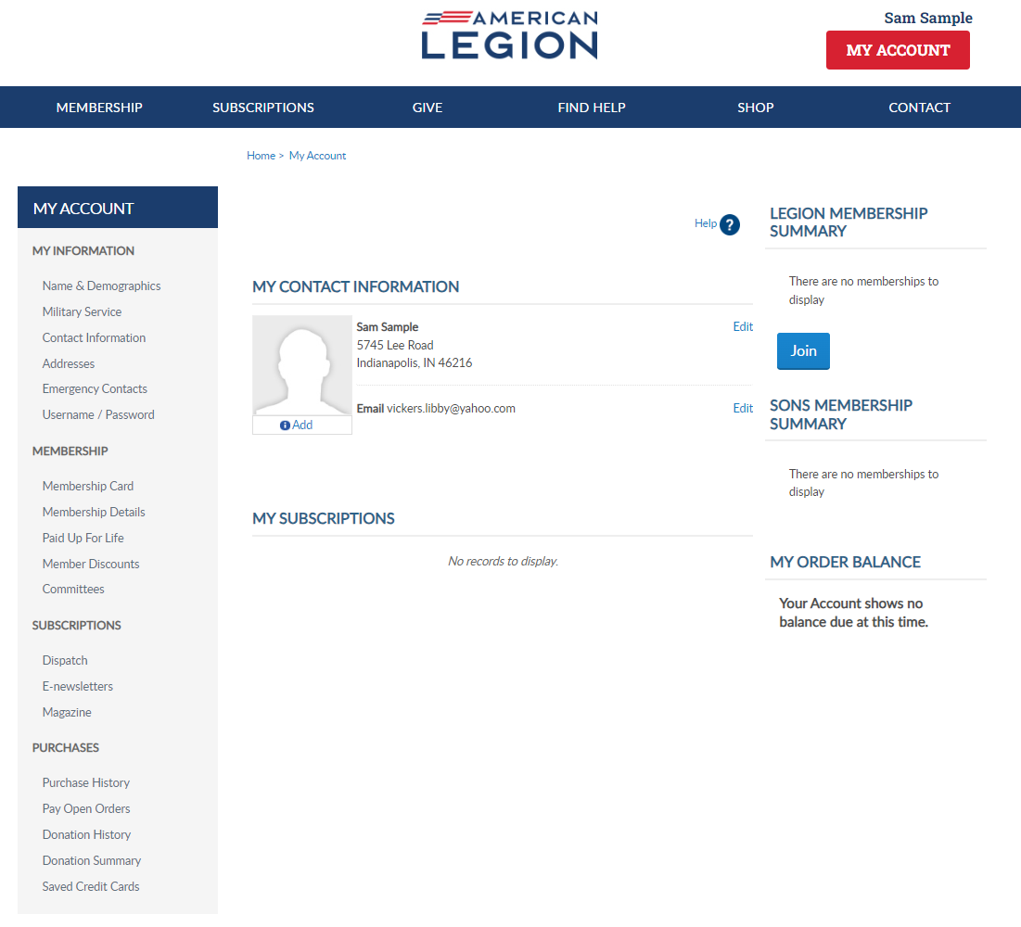
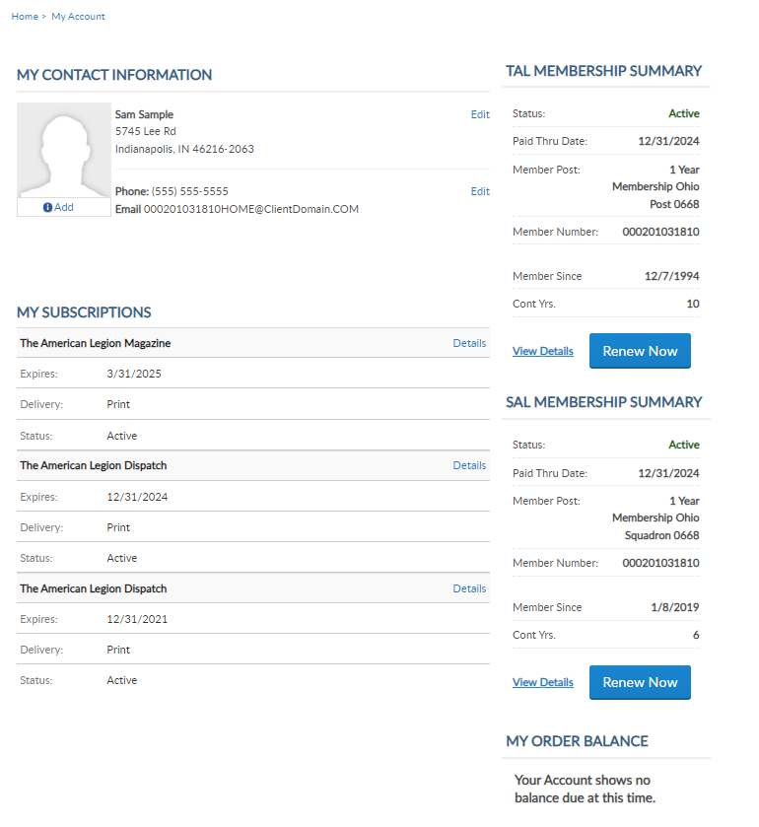
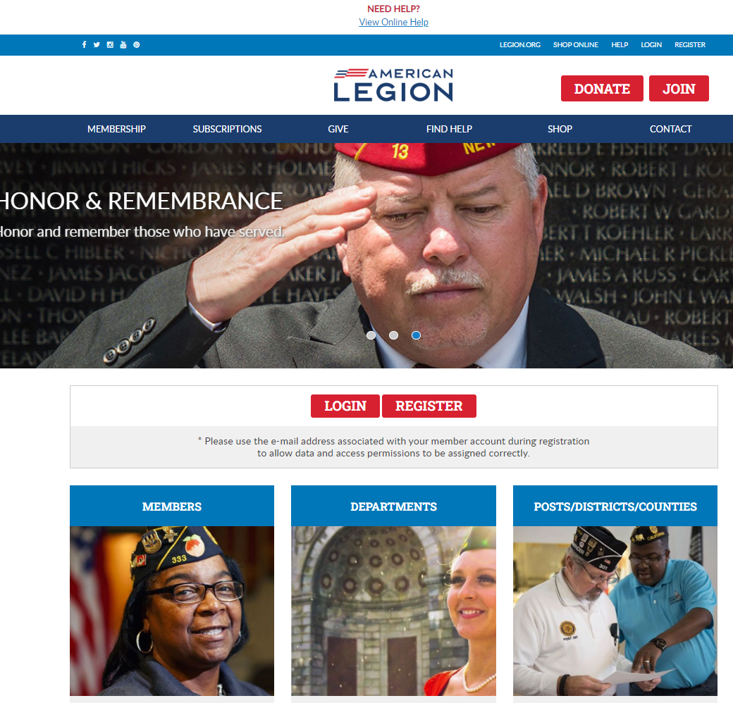
MYLEGION.ORG
emailaddress@yahoo.com
000123456789
Expired
000123456789
Notes:
Administrative membership management tools are available through MyLegion. Begin by logging into MyLegion and proceed to the My Groups menu. My Groups is the administrative side of myLegion available to adjutants and commanders and assigned administrators. If you do not have a My Groups menu and are a current adjutant or commander, contact your department headquarters.

Slide 3
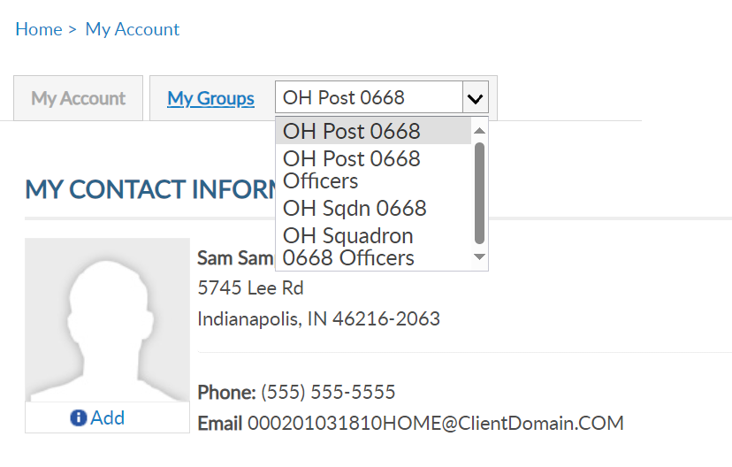
MY GROUPS
Adjutants and Commanders
Legion has LGN and SAL
Officer Groups: view only
emailaddress@yahoo.com
000123456789
emailaddress@yahoo.com
Expired
000123456789
Notes:
My Groups is available from member’s MyLegion accounts when they are recorded as an adjutant or commander of a post, squadron, district, county, department and detachment. Legion leadership have access to both legion and Sons of the American Legion groups. <1> Officer groups are view only. All officers are reported through department headquarters.
This member is a post adjutant. Post adjutants and commanders have access to both post and squadron membership and officer groups.
Clicking on the group will navigate you to the administrative side of MyLegion, group profile.

Slide 4
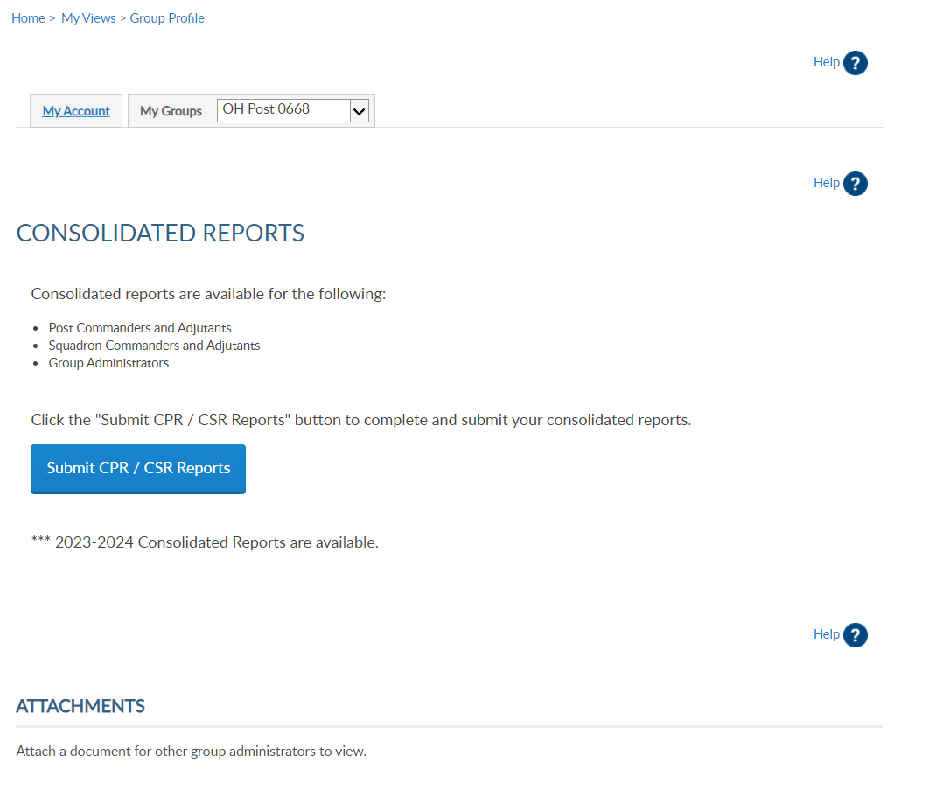
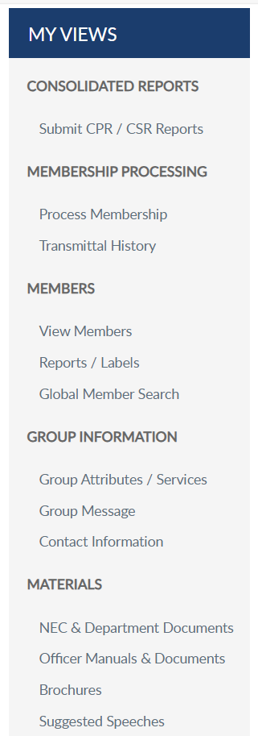
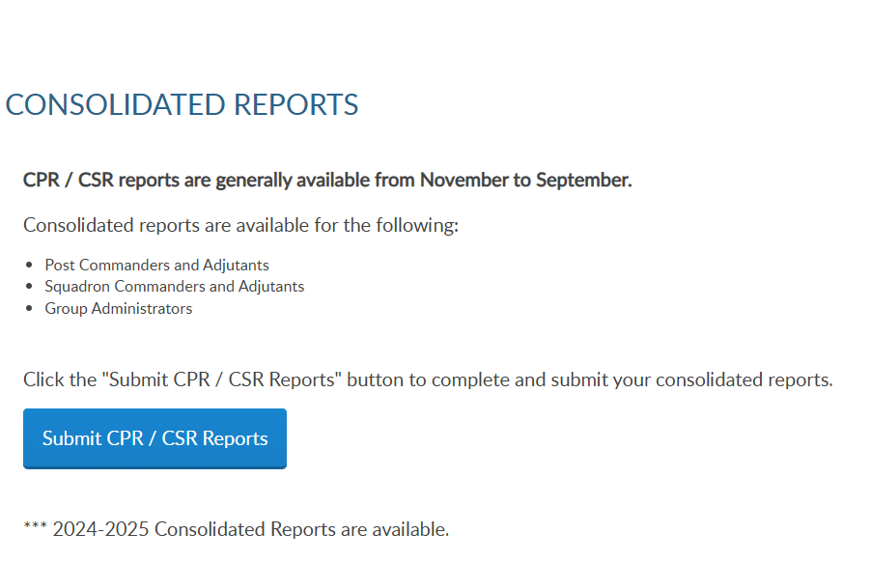
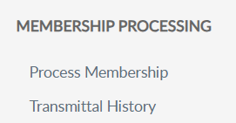
GROUP PROFILE
Notes:
The group profile window includes a menu with administrative tools. Membership processing allows you to submit transmittals and view transmittal history.
Create a transmittal by going to Process Membership. You can also access membership processing through View Members. <1> Either option opens the Members window.
In this example, we will add and finalize a post transmittal. The post is selected in group menu, click Process Membership.

Slide 5
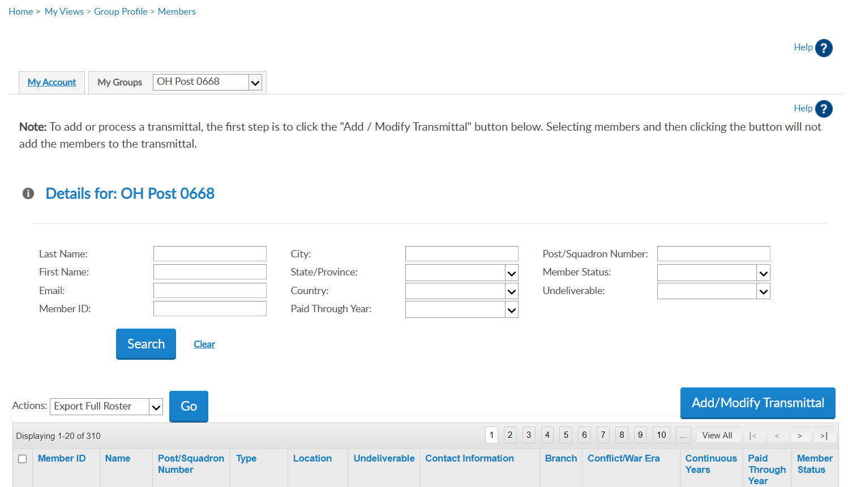
123456781 | AaExample, James | American Legion OH Post 0668 | 1 Year Mbrship | Address |  | email address Phone | USAF | VIETNAM | 5 | 2024 | Expired
123456782 | AaExample, Jr, Fred | American Legion OH Post 0668 | PUFL renewal | Address |  | Phone | USAF | KOREA | 49 | 2025 | Active
123456783 | AaSample, Allen | American Legion OH Post 0668 | 1 Year Mbrship | Address |  | email address Phone | USA | VIETNAM | 20 | 2027 | Active
102222456
Notes:
View members displays current, expired and deceased members.

Slide 6
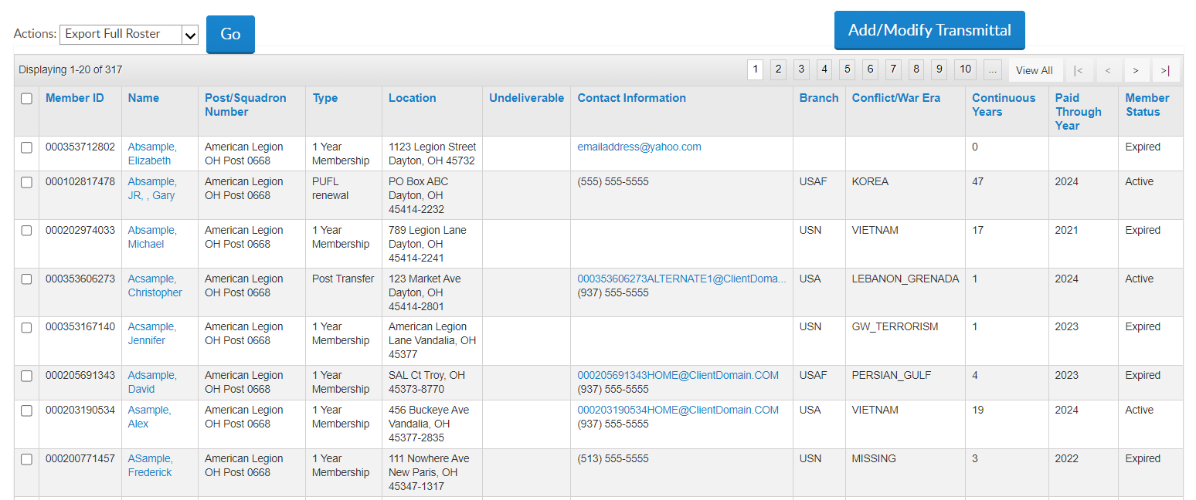
View Members List
123456781 | AaExample, James | American Legion OH Post 0668 | 1 Year Mbrship | Address |  | email address Phone | USAF | VIETNAM | 5 | 2024 | Expired
123456782 | AaExample, Jr, Fred | American Legion OH Post 0668 | PUFL renewal | Address |  | Phone | USAF | KOREA | 49 | 2025 | Active
123456783 | AaSample, Allen | American Legion OH Post 0668 | 1 Year Mbrship | Address |  | email address Phone | USA | VIETNAM | 20 | 2027 | Active
123456784 | AaSample2, Alex | American Legion OH Post 0668 | 1 Year Mbrship | Address | * |  | USN | GW_TERRORISM | 1 | 2023 | Expired
123456785 | AbExample, Kathy | American Legion OH Post 0668 | 1 Year Mbrship | Address |  | email address | USA | OTHER | 0 | 2025 | Active
123456789 | AcSample, Christopher | American Legion OH Post 0668 | 1 Year Mbrship | Address |  | email address Phone | USMC | PERSIAN_GULF | 1 | 2025 | Active
123456787 | AcSample, Jesse | American Legion OH Post 0668 | 1 Year Mbrship | Address |  | email address | USA | GW_TERRORISM | 1 | 2023 | Expired
123456788 | AdExample, Johnathan | American Legion OH Post 0668 | Department Life | Address |  |  |  | VIETNAM | 42 | 2025 | Active
 |  |  | 1 Year Mbrship
Notes:
This page displays a Add/Modify Transmittal button for post and squadron groups for online membership processing. This is also the location to email a member or group of members.
Notice in this listing displays the Paid Through Year. Members paid for the current membership year are not eligible for renewal and will not be in renewal list. To begin a transmittal, click “Add/Modify Transmittal”. <1>

Slide 7
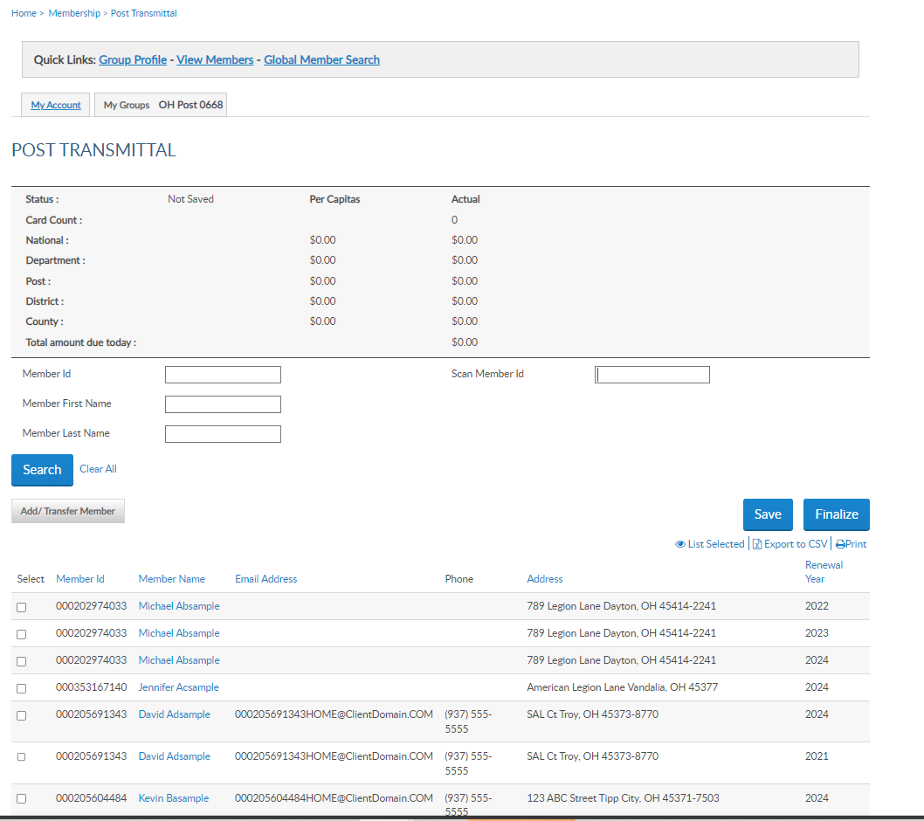
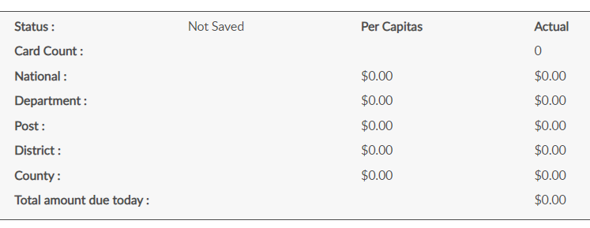
Online Help
Transmittal Summary
123456781 | AaExample, James | Email | Phone | Address | 2025
123456784 | AaSample2, Alex | Email | Phone | Address | 2024
123456784 | AaSample2, Alex | Email | Phone | Address | 2025
123456787 | AaSample2, Jesse | Email | Phone | Address | 2024
123456787 | AsSample2, Jesse | Email | Phone | Address | 2025
123456790 | Bsample, Kathy | Email | Phone | Address | 2025
123456795 | Csample, Jason | Email | Phone | Address | 2025
Notes:
The post transmittal page open to begin adding members to the batch. The transmittal summary <1> includes transmittal status, number of cards, and per capita allocations. Total amount includes national and department only. These amounts do not display until a member is added to the batch, The summary area recalculates with each entry.

Slide 8
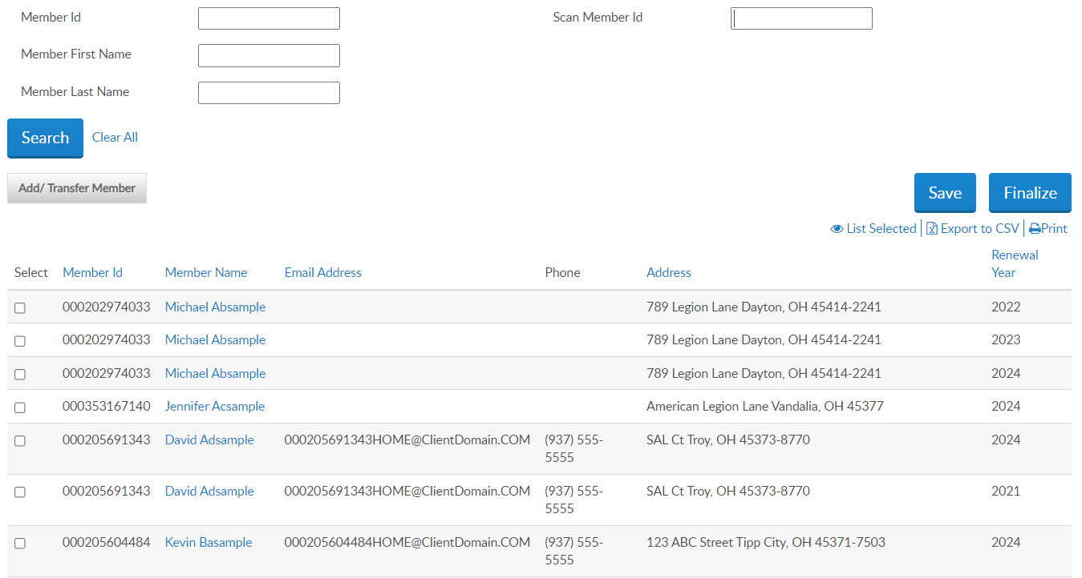
123456784
Last Member Id 123456784 Scanned and Saved in transmittal.
123456781 | AaExample, James | Email | Phone | Address | 2025
123456784 | AaSample2, Alex | Email | Phone | Address | 2024
123456784 | AaSample2, Alex | Email | Phone | Address | 2025
123456787 | AaSample2, Jesse | Email | Phone | Address | 2024
123456787 | AsSample2, Jesse | Email | Phone | Address | 2025
123456790 | Bsample, Kathy | Email | Phone | Address | 2025
123456795 | Csample, Jason | Email | Phone | Address | 2025
123456789
123456784 Alex AaSample2 Email Phone Address 2025
123456789
123456789
123456000
123454321
123454321
1234543222
Notes:
The listing in post transmittal only displays names of members eligible for renewal. <1> Members with more than one eligible renewal year will have a line for each eligible renewal year. Current paid members will not display in this listing.
The renewal list is alphabetic. To add a member to the batch, select the box for the correct renewal year. You can search a member by ID or name.
<1> The scan member ID field is for departments and large posts using bar code scanners. This allows you to scan the barcode from the membership card to auto enter in the field. The 'Scan Member Id' box only applies to the current membership year and saves the record to the batch. However, you don't have to use a scanner to utilize the "Scan Member Id" box; you can just type the ID <2> and hit enter and it will add the member to the transmittal.
If you do not find the member to renew, the member is either already paid, in a pending transmittal, transferred out of your post, or expired for greater than 2 years. Tools available to determine the members status are in Transmittal History, Current Roster, and Roster Updates.

Slide 9
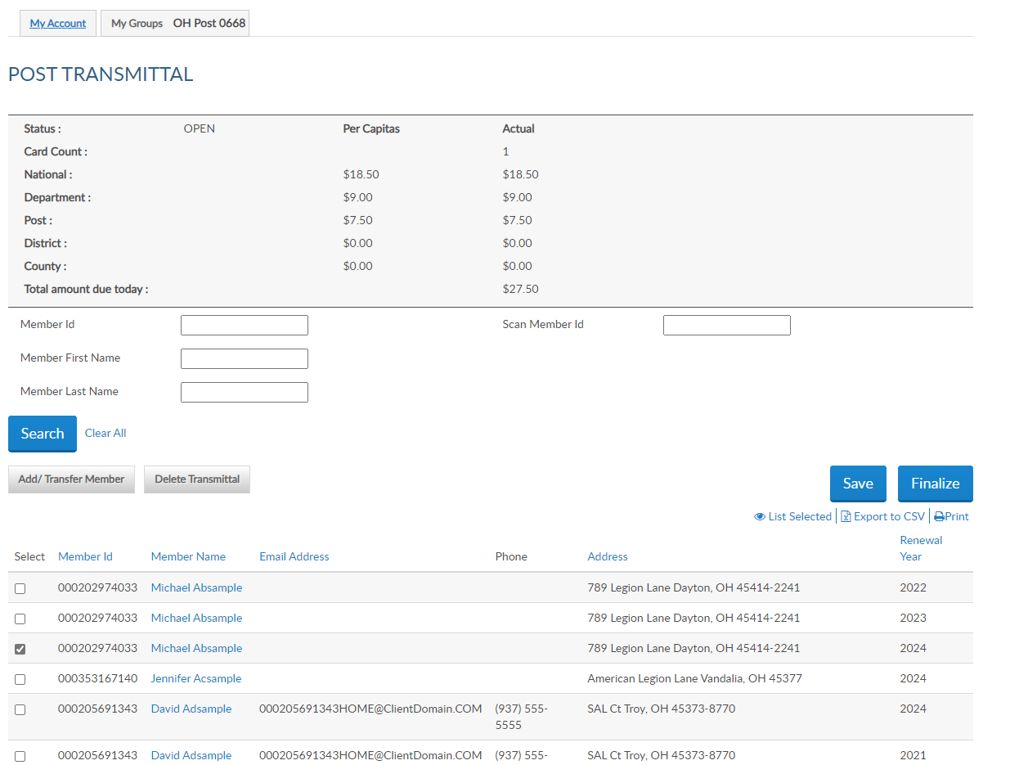
123456781 | AaExample, James | Email | Phone | Address | 2025
123456784 | AaSample2, Alex | Email | Phone | Address | 2024
123456784 | AaSample2, Alex | Email | Phone | Address | 2025
123456787 | AaSample2, Jesse | Email | Phone | Address | 2024
123456787 | AsSample2, Jesse | Email | Phone | Address | 2025
123456790 | Bsample, Kathy | Email | Phone | Address | 2025
123456795 | Csample, Jason | Email | Phone | Address | 2025
Notes:
Saving the batch updates the status to Open. Open batches must be finalized in 14 days, or it will be removed. The batch will have to be re-entered.
<1> The member’s current year renewal is checked, adding the member to the batch. If the member is paying past dues, check the boxes for the renewal year. You can process more than one year renewal in the same batch. The batch summary amount due calculates with each member added to the batch. The total amount due equals the department and national per capita only.
Continue renewing members using search to check the renewal year. Save each entry as you go if not using scan member ID and when all names are added finalize the batch. <2> Exiting this area without saving the batch will result in having to re-enter any entries made.

Slide 10
Online Help
Add member
123456781 | AaExample, James | Email | Phone | Address | 2025
123456784 | AaSample2, Alex | Email | Phone | Address | 2024
123456784 | AaSample2, Alex | Email | Phone | Address | 2025
123456787 | AaSample2, Jesse | Email | Phone | Address | 2024
123456787 | AsSample2, Jesse | Email | Phone | Address | 2025
123456790 | Bsample, Kathy | Email | Phone | Address | 2025
123456795 | Csample, Jason | Email | Phone | Address | 2025
1234543222
Notes:
To add a new member or transfer a member select the Add/Transfer Member button. Let’s add a new member to the post.

Slide 11
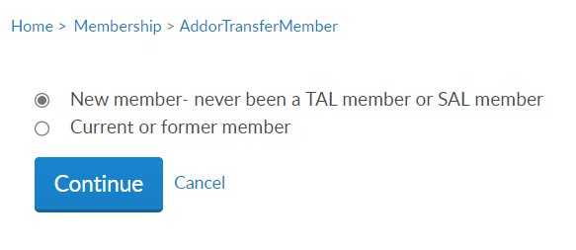
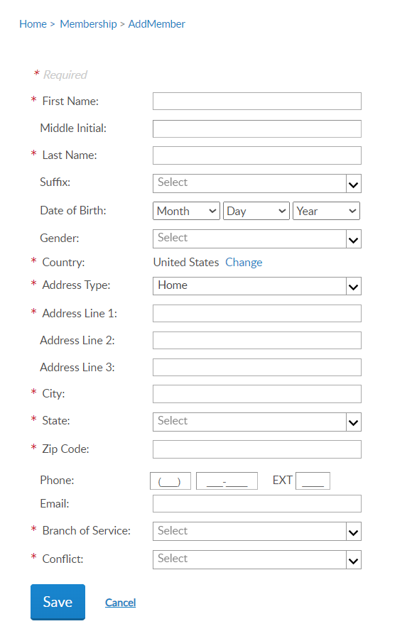
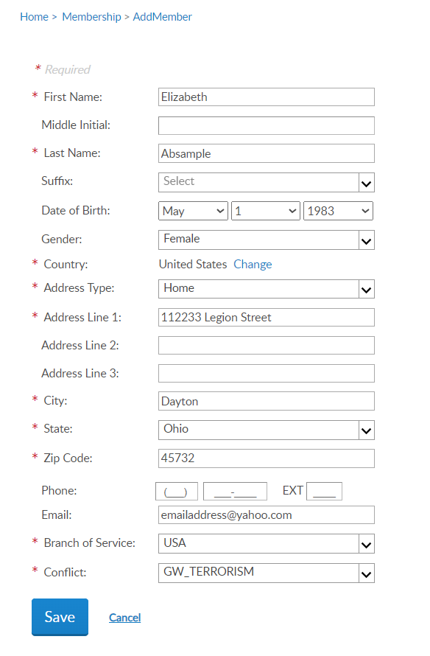
Online Help
Member is deeply expired, and no renewal order exists.
New member created a MyLegion account prior to joining.
New member has a squadron membership.
Notes:
Select “new member – never been an American Legion or Sons of the American Legion member and click continue.
Enter the member’s information and Save. <1> Fields with an asterisk are required. To enter a foreign address, use the pulldown menu in country, to select country.
A message will occur <2> “A Customer exists with matching details with the member ID#” for the following reasons:
<3> The member is deeply expired, and no renewal order exists to fulfill, <4> the new member created a myLegion account prior to joining, or <5> the new member has a squadron membership. If this message appears, capture the ID number, click cancel to return to post transmittal, and process as current or former member.

Slide 12
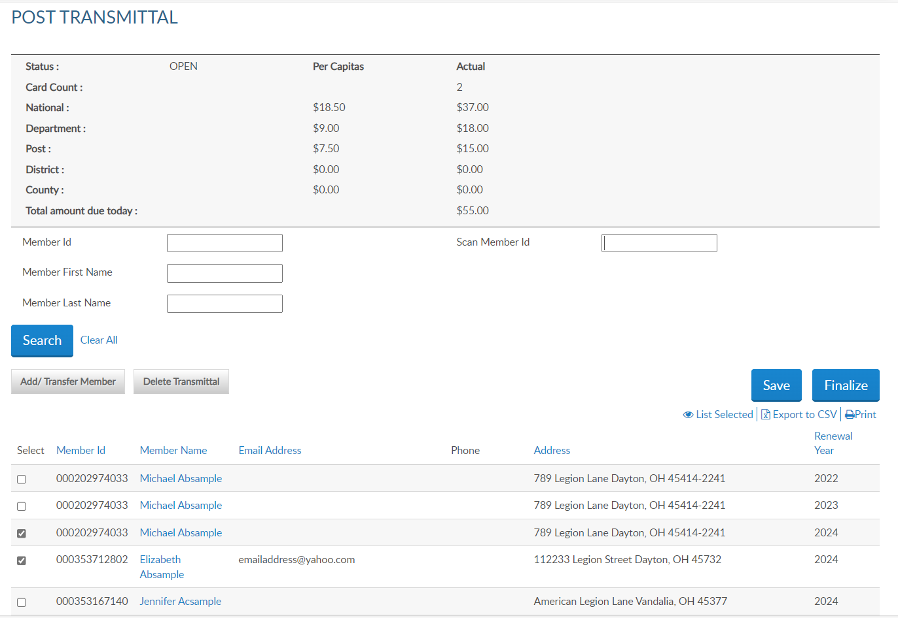
Online Help
Transfer member
123456781 | AaExample, James | Email | Phone | Address | 2025
123456784 | AaSample2, Alex | Email | Phone | Address | 2024
123456784 | AaSample2, Alex | Email | Phone | Address | 2025
351234567 | AbSample, Elizabeth | Email | Phone | Address | 2025
123456787 | AaSample2, Jesse | Email | Phone | Address | 2024
123456787 | AsSample2, Jesse | Email | Phone | Address | 2025
123456795 | Csample, Jason | Email | Phone | Address | 2025
Notes:
The new member is added to the list and the summary updates. New members will appear on your member listing with 0 continuous years until the batch completes.
Save each entry to prevent losing members in the batch. Always save the batch before exiting.
The next transaction available using online membership processing is transferring members into your post. Only members that are renewing dues can be transferred online. To transfer paid members, complete a Member Data Form and send to your department.
<1> To transfer a renewing member, select Add/Transfer Member.

Slide 13
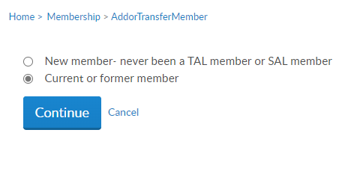
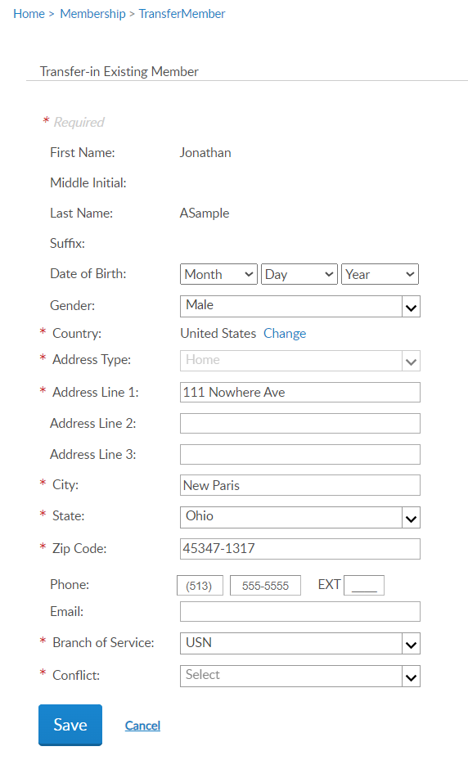
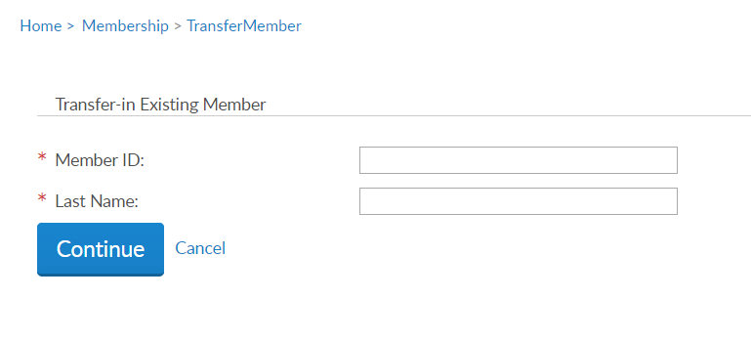
Online Help
Frederick
Notes:
Select current or former member and continue. <1> Enter the member ID# and last name and continue. <2>
Update any information needed and add any required data. Click Save to add the member to the batch.

Slide 14
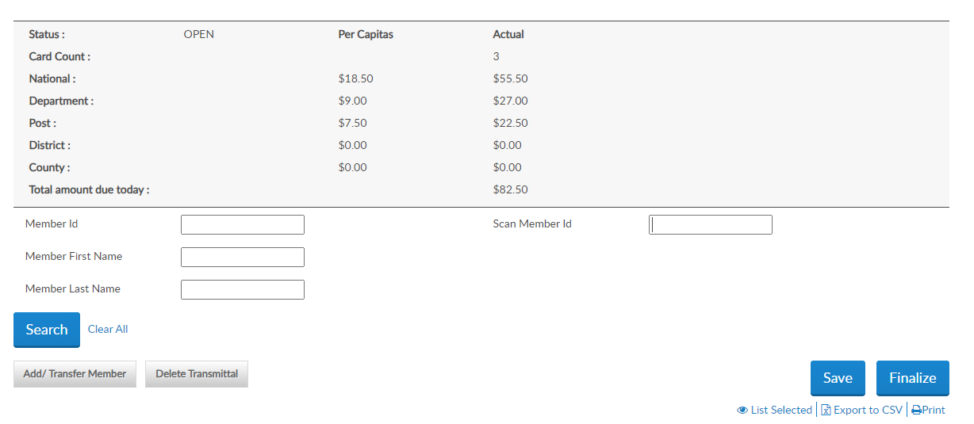
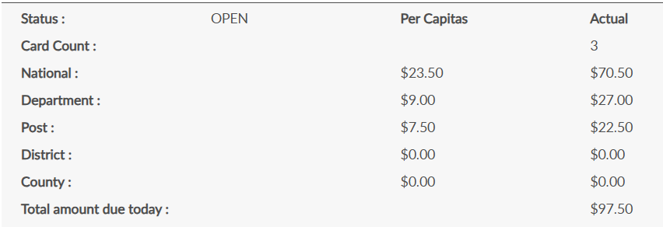
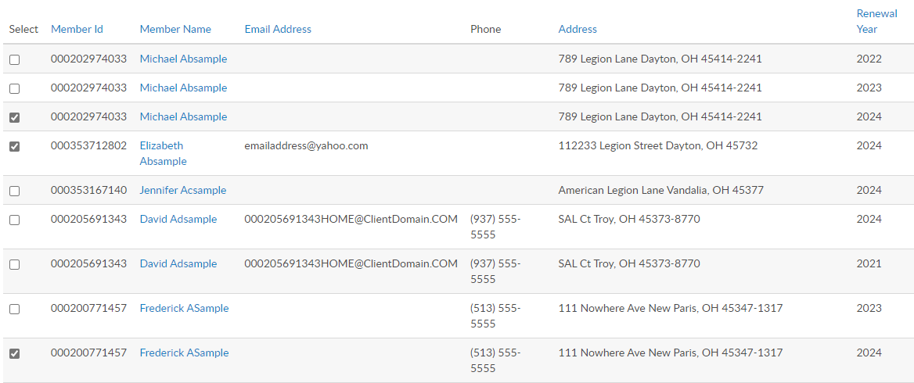
Online Help
123456900 | ASample, Frederick | Email | Phone | Address | 2025
123456781 | AaExample, James | Email | Phone | Address | 2025
123456784 | AaSample2, Alex | Email | Phone | Address | 2024
123456784 | AaSample2, Alex | Email | Phone | Address | 2025
351234567 | AbSample, Elizabeth | Email | Phone | Address | 2025
123456787 | AaSample2, Jesse | Email | Phone | Address | 2024
123456787 | AsSample2, Jesse | Email | Phone | Address | 2025
123456795 | Csample, Jason | Email | Phone | Address | 2025
123456795 | Dsample, Helen | Email | Phone | Address | 2025
123454321
122333444
122333444
Notes:
The Summary recalculates with the total amount due. The amount due equals department plus national per capita.
To remove members from the transmittal, uncheck the box next to the name and the summary will recalculate. To delete the whole transmittal, select “Delete Transmittal”. <1>

Slide 15
Online Help
123456900 | ASample, Frederick | Email | Phone | Address | 2025
123456781 | AaExample, James | Email | Phone | Address | 2025
123456784 | AaSample2, Alex | Email | Phone | Address | 2024
123456784 | AaSample2, Alex | Email | Phone | Address | 2025
351234567 | AbSample, Elizabeth | Email | Phone | Address | 2025
123456787 | AaSample2, Jesse | Email | Phone | Address | 2024
123456787 | AsSample2, Jesse | Email | Phone | Address | 2025
123456795 | Csample, Jason | Email | Phone | Address | 2025
123456795 | Dsample, Helen | Email | Phone | Address | 2025
Notes:
After all records are entered you can view the batch by clicking “List Selected”. The Finalize button directs you to the same page. Payment information will be entered during finalization if not already stored.
Open batches must be finalized within 14-days or automatically be removed. The members will have to be re-entered.

Slide 16
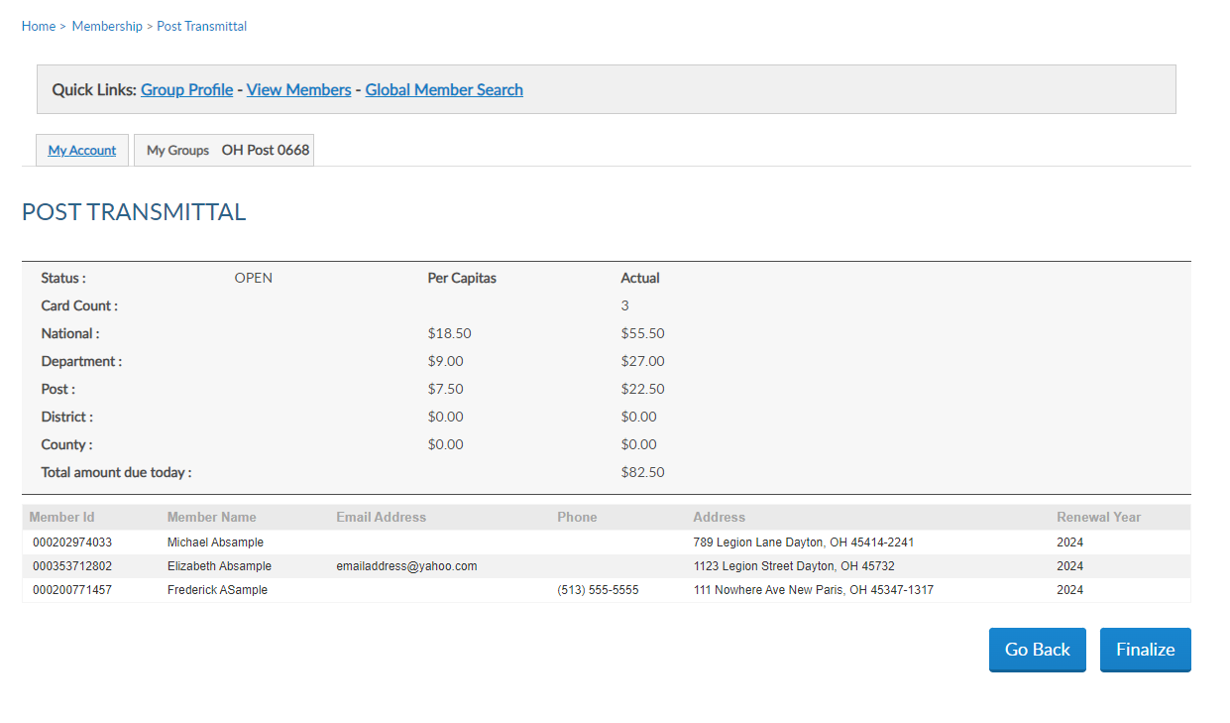
Online Help
123456900 | ASample, Frederick | Email | Phone | Address | 2025
123456784 | AaSample2, Alex | Email | Phone | Address | 2025
351234567 | AbSample, Elizabeth | Email | Phone | Address | 2025
Notes:
Selecting view list or finalize displays the members in the batch and the total amount due . Click finalize to continue or Go Back to return to transmittal list.

Slide 17
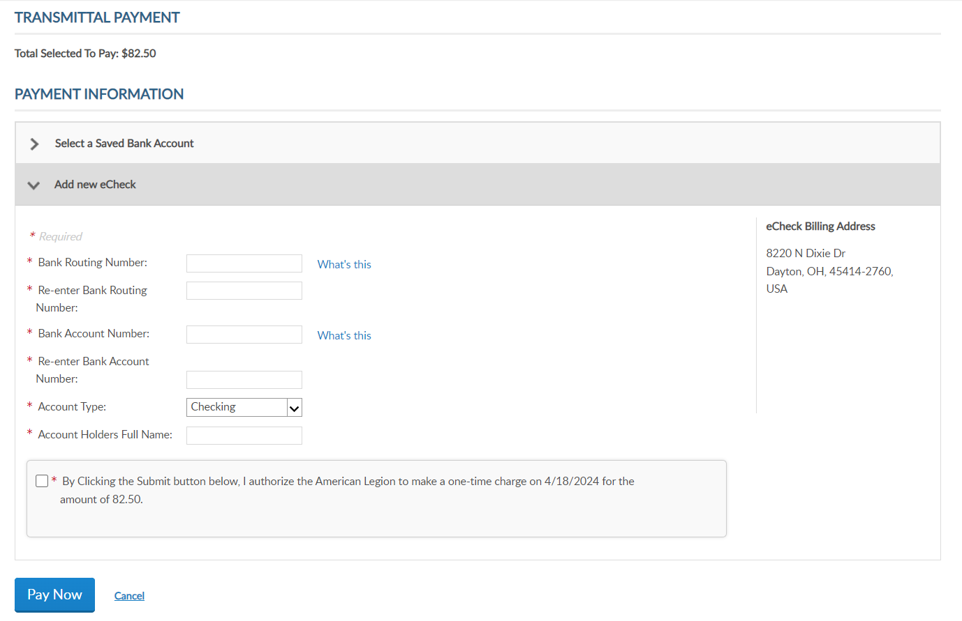
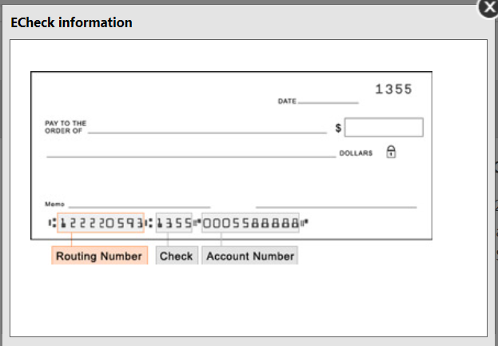
Online Help
Total Selected to Pay: $97.50
Address1
Dayton, OH 45414
USA
* By Clicking the Submit button below, I authorize the American Legion to make a one-time charge on 2/18/2025 for $97.50.
* By Clicking the Submit button below, I authorize the American Legion to make a one-time charge on 2/18/2025 for $97.50.
Notes:
Payment information must be entered when finalizing your first transmittal. Enter the routing and bank account information. The Account Holder’s name is the name of the post or squadron bank account. When entering, use a specific description instead of a generic name as in American Legion Post 1.
<1> The easiest place to find your bank’s routing number is to look at your paper checks. The check will typically have the 9-digit routing number down on the bottom left of the check. All routing numbers are 9 digits.
Foreign posts and squadrons can process membership with a credit card. Online membership processing is designed for payment to be processed with a post or squadron account and not with individual credit cards.
The only payment method for US posts is eCheck. Enter the bank account information, authorize the one-time charge by clicking the checkbox and Pay Now.
This information will be stored for future transmittals. Entering new payment information holds future transmittal from finalizing until the first transmittal completes. This is to ensure all subsequent transmittals have valid bank information.
If you receive an error when entering payment information, contact your financial institution to verify ACH payment account information.

Slide 18
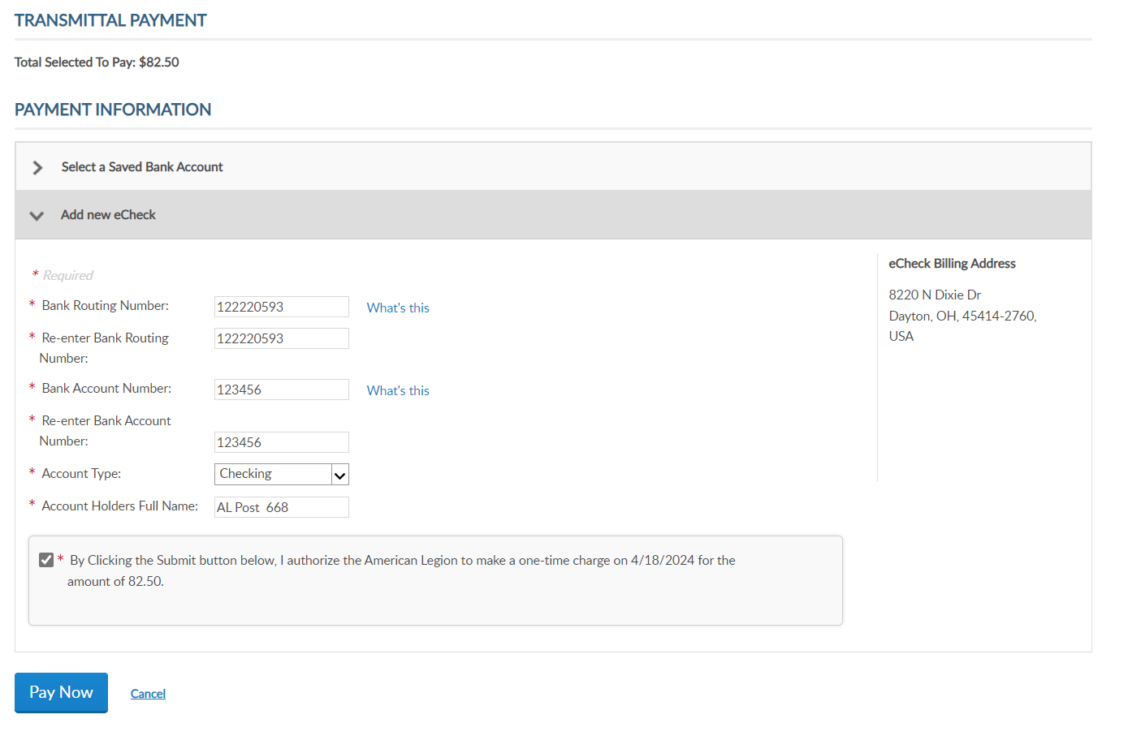
Online Help
Total Selected to Pay: $97.50
* By Clicking the Submit button below, I authorize the American Legion to make a one-time charge on 2/18/2025 for $97.50.
Notes:
After payment information is entered, click the authorization box and Pay Now.

Slide 19
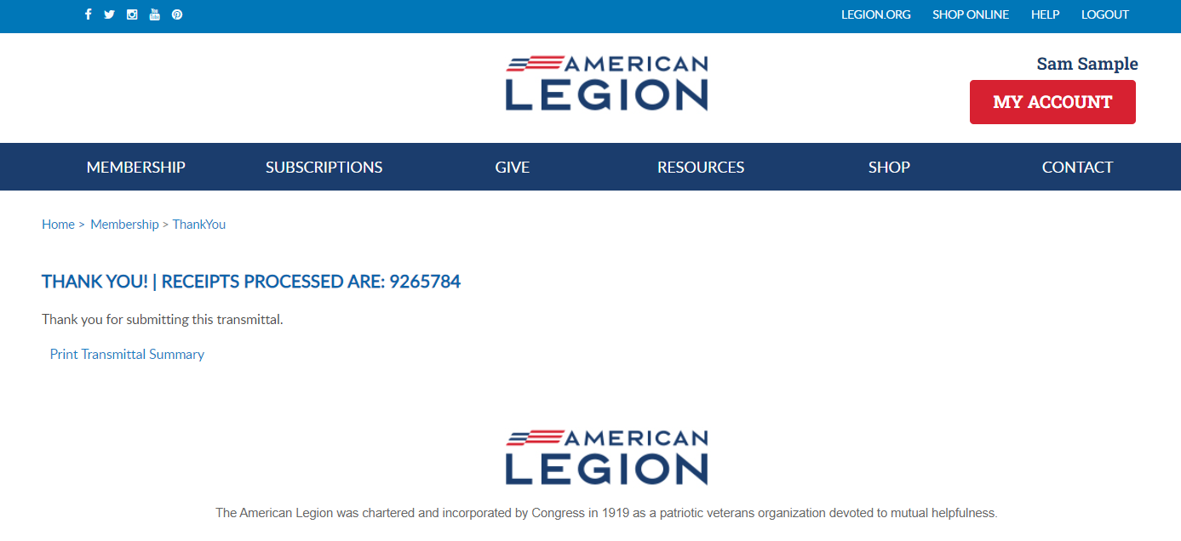
Online Help
Notes:
Finalization of a transmittal produces a receipt number. This is notification the transmittal has been received and is in process. While in pending status, counts are added to the National Target Date membership reports and are immediately available for Departments to add to their membership reports. Legion members do not receive renewal notices and it prevents them from renewing online that creates duplicate payments.
To view the transmittal summary, and print the receipt, click Print Transmittal Summary.

Slide 20
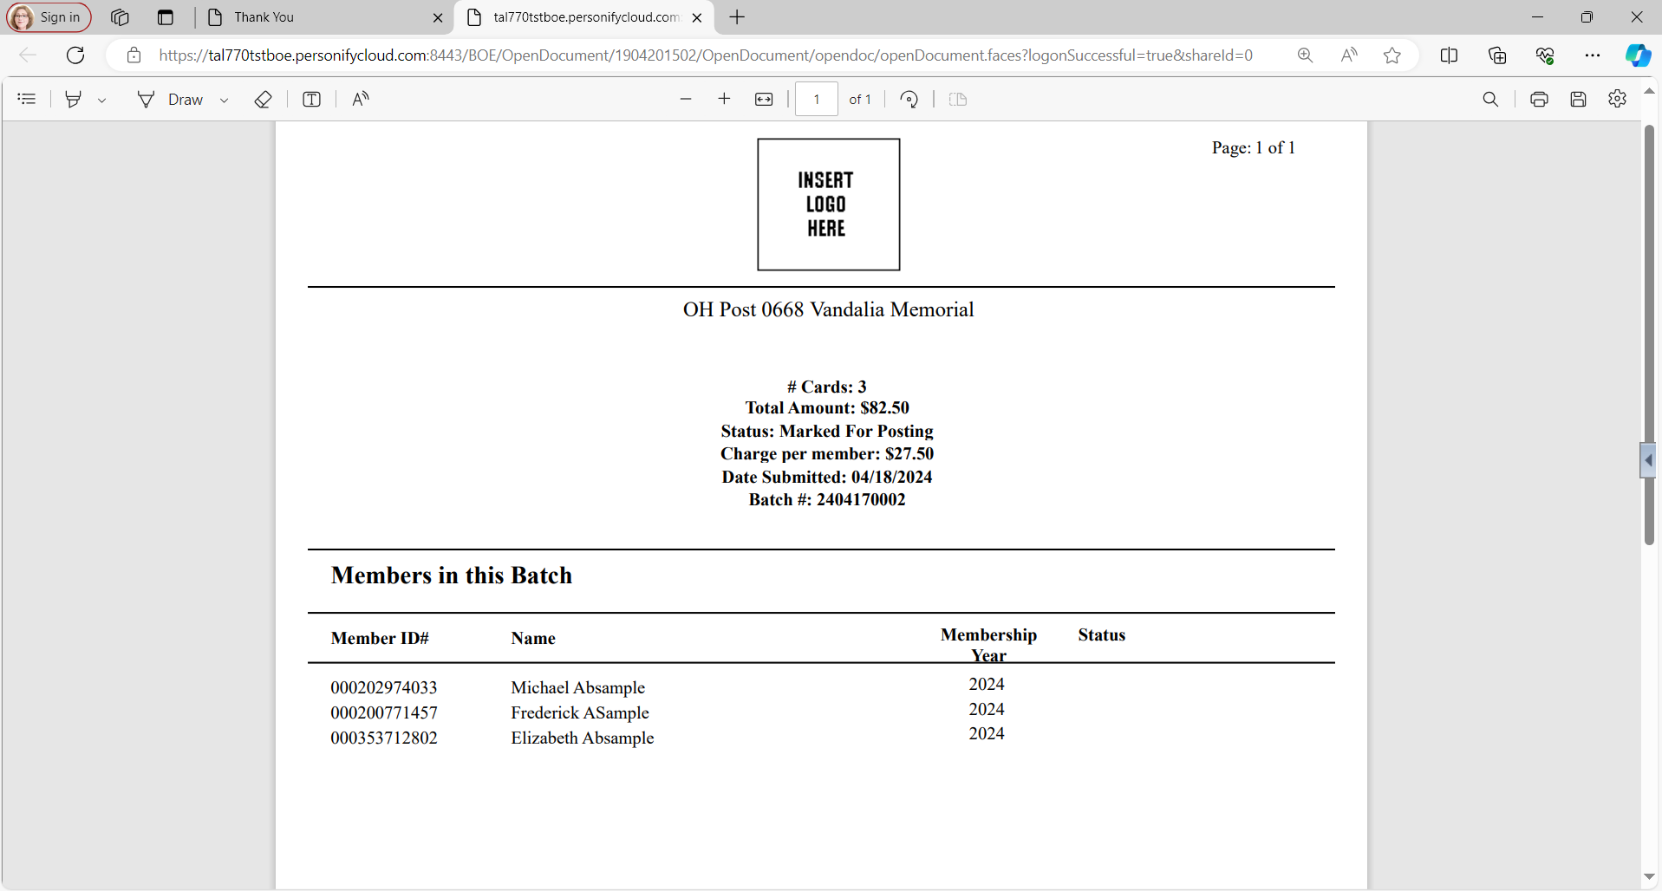
Online Help
# Cards: 3
Total Amount: $97.50
Status: Marked For Posting
Charge per member: $32.50
Date Submitted: 02/18/2025
Batch #: 2502010002
123456900 | ASample, Frederick | 2025
123456784 | AaSample2, Alex | 2025
351234567 | AbSample, Elizabeth | 2025
Notes:
The receipt opens in another tab to print or Save this document for your records. This information is also available in your transmittal history.

Slide 21
Online Help
emailaddress@yahoo.com
Notes:
Return to your group profile to view transmittal status and history. Go back to My Account > My Groups.

Slide 22
GROUP PROFILE
Notes:
Go to Transmittal History. <1> Transmittal history includes reference number, membership year, status, actual number of members submitted and total amount.
Using the Range search field, you can alter the history displayed. Custom range pulls up date fields to set the range of history. Online transmittal history is only available from April 1, 2021 to current.
Clicking on the transmittal number opens details including members in the batch, amount and status.

Slide 23
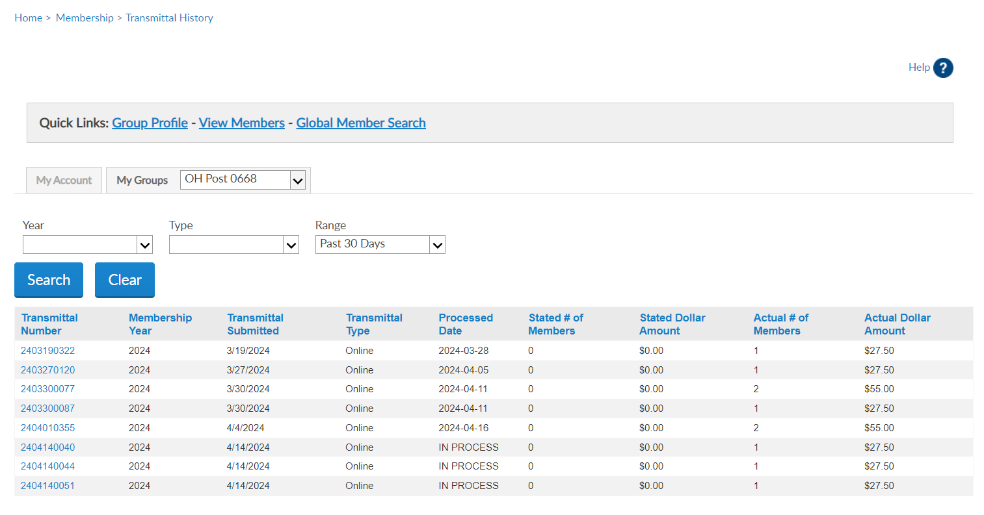
$82.50
Notes:
Go to Transmittal History. <1> Transmittal history includes reference number, membership year, status, actual number of members submitted and total amount.
Using the Range search field, you can alter the history displayed. Custom range pulls up date fields to set the range of history. Online transmittal history is only available from April 1, 2021 to current.
Clicking on the transmittal number opens details including members in the batch, amount and status.

Slide 24
IMPORTANT INFO
Online Membership Processing
Payment information is entered when finalizing the first transmittal and stored for future batches. A second transmittal cannot be finalized until the first one completes to ensure stored payment information is valid.
Open batches must be finalized within 14 days, or it will be removed, and a new batch will need to be created.
Pending transmittals in process must complete prior to making any adjustments. Renewing a member for the incorrect membership year or any other adjustments are reported to your department.
Transmittals complete in 7 business days. Member records are updated when posted. Review transmittal history to view batch status.
$10,000 batch limit.
Notes:
Important information to know about online membership processing.
<1> Payment information is entered when finalizing the first transmittal and stored for future batches. A second transmittal cannot be finalized until the first completes. This hold is to ensure payment information is stored correctly and to prevent multiple declines. Attempting to finalize a transmittal prior to the first one completing will result in an error message. This hold is activated each time new bank information is entered.
<2> Open batches are to be finalized within 14 days. Reminders to submit are emailed to adjutants and are deleted if no action is taken. All members in the transmittal will have to be re-entered in a new batch.
<3> Pending transmittals in process must complete before any adjustments can be made. Renewing a member for the incorrect membership year or any other adjustments are to be reported to your department.
<4> Current processing time is 7 business days. Member records are updated when the batch is posted. Review transmittal history to view batch status.
<5> There is a $10,000 batch limit. Amounts higher than that should be broken down to separate transmittals that meet the limit.

Slide 25
IMPORTANT INFO
Online Membership Processing
Stored bank information can be updated when finalizing a transmittal. On the payment window, select “Update Account Information”.
Declined transmittal notifications are sent to adjutants. Declined batches can be resubmitted. Contact myLegion support for questions regarding declined batches.
Available for posts, squadrons, detachments and departments. District and County groups do not have online membership processing.
Notes:
Stored bank information can be updated when finalizing a transmittal. On the payment window, select “Update Account Information”.
<1> Declined batches can be resubmitted. Contact myLegion support for questions regarding declined batches.
<2> Online membership processing is available for posts, squadrons, detachments and departments. Distirct and County groups do not have this feature.

Slide 26
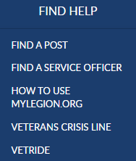
emailaddress@yahoo.com
000123456789
Expired
000123456789
Notes:
Online help is available from the top Menu “Find Help”.
Step by step instructions, videos and training presentations will assist with how to manage groups in MyLegion.

Slide 27
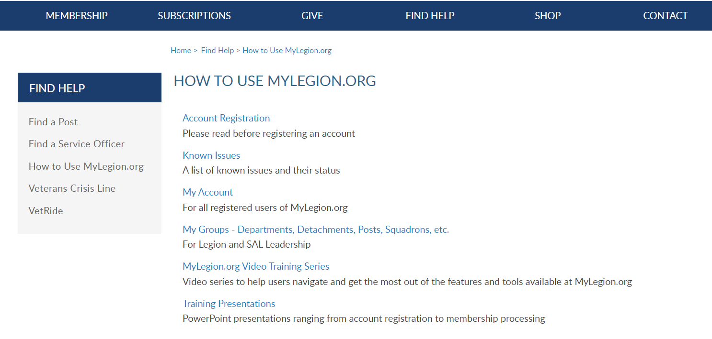
Online Help
Notes:
Step by step instructions, videos and training presentations will assist with how to manage groups in MyLegion. My Groups instructions include managing membership, online, membership processing, reports and all other administrative tasks.

Slide 28
MYLEGION SUPPORT
MyLegion@legion.org
833.253.9995
Monday – Friday
8:00am – 4:30pm
(Eastern)
The American Legion National HQs
5745 Lee Road
Indianapolis, IN 46216
Contact your MyLegion support team to assist with any questions or tools on your MyLegion account.
Notes:
Contact your myLegion support team to assist with questions and tools for MyLegion. Email mylegion@legion.org or call 833-253-9995 Monday through Friday.

